Slide 1
Dr.Widad Saleh
Fiber-Reinforced Polymers (FRP)
Lecture Four
FRP is categorized as a composites materials consisting of fibers and matrix resin. The fibers are responsible for providing the composities with strength and modulus, whereas the resin protects the fibers from physical or environmental deterioration
-- Fibers may be surface treatments to improve the bond strength against a polymeric resins.
--- The direction of the fibers controls the mechanical properties of FRP Composites.
--- The properties of FRP are dependent on the characteristics of fibers embedded in the resin , such as their amounts , orientation angles and types .
So for highway infrastructuers application, three types of FRP composites have been traditionally used : CFRP,GFRP and AFRP.

Slide 2
Q1: What is the advantages and disadvantages of FRP composites.
Q2: Why use thermoset resins as binder materials more than thermoplastic resin in the synthesis of CFRP and others in highway infrastractions.

Slide 3
most reinforcements used in composites have a fibrous form because materials are stronger and stiffer in the fibrous form than in any other form.
most interested in the so-called advanced fibers, which possess very high strength and very high stiffness coupled with a very low density.
The use of fibers as high-performance engineering materials is based on three important characteristics
1-A small diameter with respect to its grain size or other microstructural unit. Figure 1.shows that the strength of a carbon fiber decreases as its diameter increases.
Reinforcements
Dr.Widad Saleh
3rd Lecture

Slide 4
2- A high aspect ratio (length/diameter, l/d), which allows a very large fraction ofthe applied load to be transferred via the matrix to the stiff and strong fiber.
3-A very high degree of flexibility, which is really a characteristic of a material that has a low modulus or stiffness and a small diameter. This flexibility permits the use of a variety of techniques for making composites with these fibers.
Fiber spinning is the process of extruding a liquid through small holes in a spinneret to form solid filaments
Fiber Spinning Processes
Wet spinning. A solution is extruded into a coagulating bath. The jets of liquid freeze or harden in the coagulating bath as a result of chemical or physical changes.
Dry spinning. A solution consisting of a fiber-forming material and a solvent isextruded through a spinneret. A stream of hot air impinges on the jets of solution emerging from the spinneret, the solvent evaporates, and solid filaments are left t behind

Slide 5
Melt spinning. The fiber-forming material is heated above its melting point and the molten material is extruded through a spinneret. The liquid jets harden into solid filaments in air on emerging from the spinneret holes.
Dry jet–wet spinning. This is a special process devised for spinning of aramid
Fibers.In this process, an appropriate polymer liquid crystal solution is extruded
through spinneret holes, passes through an air gap before entering a coagulation
bath, and then goes on a spool for winding

Slide 6
The process of extrusion through a spinneret results in some chain orientation in the
filament. Generally, the molecules in the surface region undergo more orientation
than the ones in the interior because the edges of the spinneret hole affect the near surface
molecules more. This is known as the skin effect.
Stretching and Orientation
The amount of stretch is generally
given in terms of a draw ratio, which is the ratio of the initial diameter to the final
diameter. For example, nylon fibers are typically subjected to a draw ratio of 5 after
spinning. A high draw ratio results in a high elastic modulus. Increased alignment of
chains means a higher degree of crystallinity in a fiber. This also affects the ability of
a fiber to absorb moisture. The higher the degree of crystallinity, the lower the moisture absorption.
The stretching treatment serves to orient the molecular structure along
the fiber axis. Such stretching
treatments do result in somewhat more efficient packing than in the unstretched
polymer,

Slide 7


Slide 8
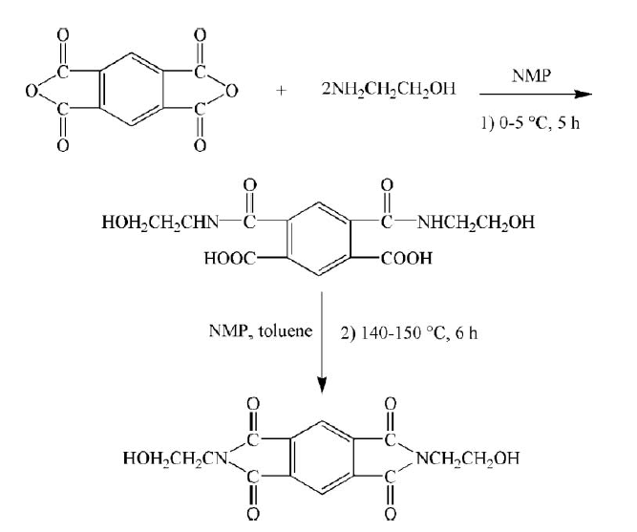
Imid dihydric alcohol

Slide 9
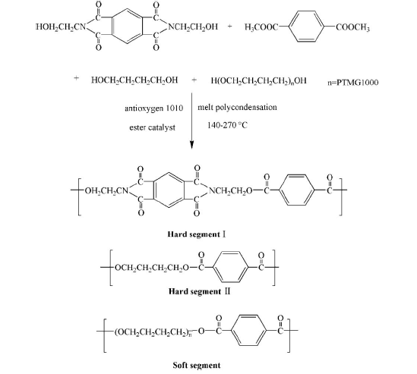

Slide 10
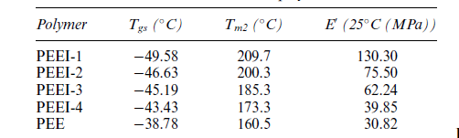
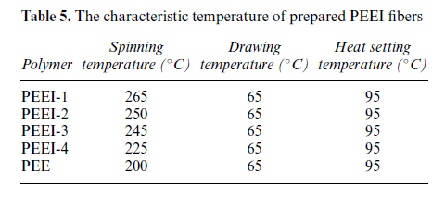

Slide 11
The tensile strength of polymer fibers at different draw ratio

Slide 12
The elongation at break of polymer fibers at different draw ratio

Slide 13
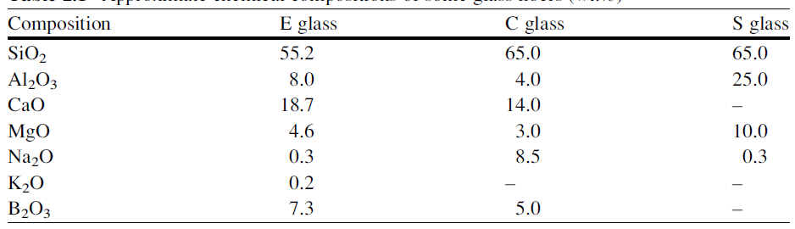
Glass fiber is a generic name like carbon fiber or steel or aluminum. Just as different compositions of steel or aluminum alloys are available, there are many of different chemical compositions of glass fibers that are commercially available. Common glass fibers are silica based (~50–60 % SiO2) and contain a host of other oxides of calcium, boron, sodium, aluminum, and iron.
1- Glass fibers

Slide 14
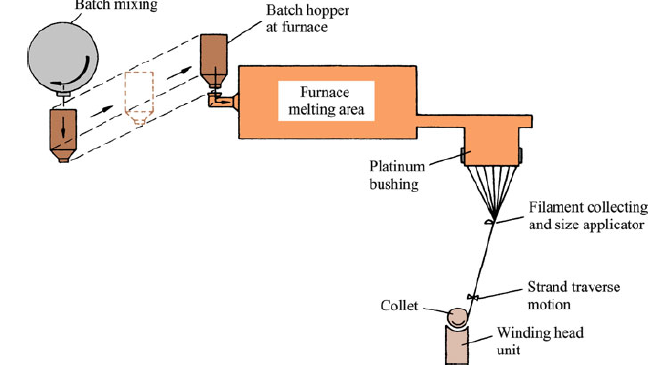
Schematic of glass fiber manufacture

Slide 15
E glass is a good electrical insulator in addition to having good
strength and a reasonable Young’s modulus; C stands for corrosion and C glass has
a better resistance to chemical corrosion than other glasses; S stands for the high
silica content that makes S glass withstand higher temperatures than other glasses.

Slide 16
The conventional methods of making glass or ceramic fibers involve drawing
from high-temperature melts of appropriate compositions. This route has many
practical difficulties such as 1- the high processing temperature required, 2- the immiscibility
of components in the liquid state, and 3- the easy crystallization during
cooling.
Q1-Why The sol–gel technique is a very
powerful technique for making glass.
Q1- A sizing treatments is important steps in the manufacturing glass fibers.why?
---the strength-to-weight ratio of glass
fibers is quite high, the modulus-to-weight ratio is only moderate. It is this latter
characteristic that led the aerospace industry
--Glass fibers continue to be used for reinforcement
of polyester, epoxy, and phenolic resins
-Glass fiber reinforced resins are used widely in the building and construction
industry. Commonly, these are called glass-reinforced plastics, or GRP
Properties and Applications

Slide 17
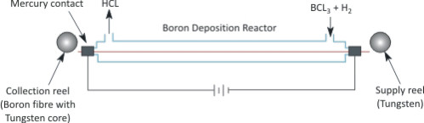
-- Boron is an inherently brittle material. It is commercially made by chemical vapor
deposition (CVD) of boron on a substrate, that is, boron fiber as produced is itself a
composite fiber.
-- The choice of substrate material that goes to form the core of the finished
boron fiber is limited. Generally, a fine tungsten wire is used for this purpose.
A carbon substrate can also be used. The first boron fibers were obtained by
Weintraub (1911) by means of reduction of a boron halide with hydrogen on a
hot wire substrate.
2- Boron fibers

Slide 18
The structure and morphology of boron fibers depend on the conditions of
deposition: temperature, composition of gases, gas dynamics,
Boron fibers produced by the CVD method described earlier have amicrocrystalline
structure that is generally called amorphous
When boron fiber is made by deposition on a tungsten substrate, as is generally
the case, then depending on the temperature conditions during deposition, the core
may consist of, in addition to tungsten, a series of compounds, such as W2B, WB,
W2B5, andWB4
Boron has a density of 2.34 g/cm3 (about 15 % less than that of aluminum).
Boron fiber with a tungsten core has a density of 2.6 g/cm3 for a fiber with 100 mm
diameter. Its melting point is 2,040 C,
Boron fiber composites are in use in a number of US military aircraft
They are also used for stiffening golf
shafts, tennis rackets, bicycle frames,

Slide 19
Fabrications
Boron fibers are obtained by CVD on a substrate. There are two processes:-
1- Thermal decomposition of a boron hydride. This method involves low
temperatures, and, thus, carbon-coated glass fibers can be used as a substrate
2- Reduction of boron halide. Hydrogen gas is used to reduce boron trihalide:
2BX3 + 3H2 2B + 6HX
where X denotes a halogen: Cl, Br, or I.

Slide 20
3- Carbon fibers
Carbon is a very light element with a density equal to 2.268 g/cm3. Carbon can exist
in a variety of crystalline forms. Our interest here is in the so-called graphitic
structure wherein the carbon atoms are arranged in the form of hexagonal layers.
There are two structural of carbon fibers , the first called graphite structure and the second called lattice structures,
Q:-what is the difference between them.
almost all
processing techniques of carbon fiber have the goal of obtaining a very high degree
of preferred orientation of hexagonal planes along the fiber axis.
Carbon fibers of extremely high modulus can be made by carbonization of
organic precursor fibers followed by graphitization at high temperatures.

Slide 21
A commonly used
precursor fiber is polyacrylonitrile (PAN). Other precursor fibers include rayon and
the ones obtained from pitches, polyvinyl alcohol, polyimides, and phenolics.
Most of the carbon fiber fabrication processes involve the following
essential steps:
1- A fiberization procedure to make a precursor fiber.
2- A stabilization treatment that prevents the fiber from melting in the subsequent
high-temperature treatments.
3- A thermal treatment called carbonization that removes most noncarbon
Elements.
4- An optional thermal treatment called graphitization that improves the properties
of carbon fiber obtained in step 3.

Slide 22
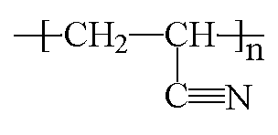
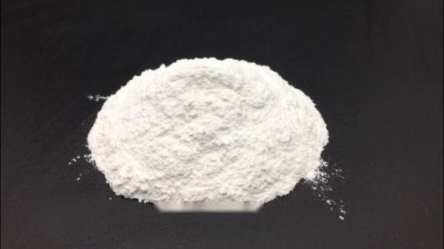

Slide 23
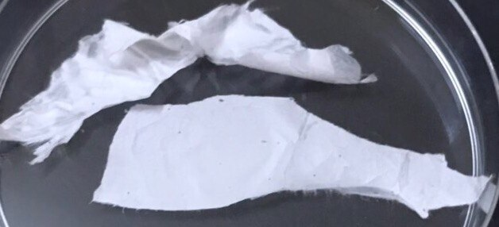
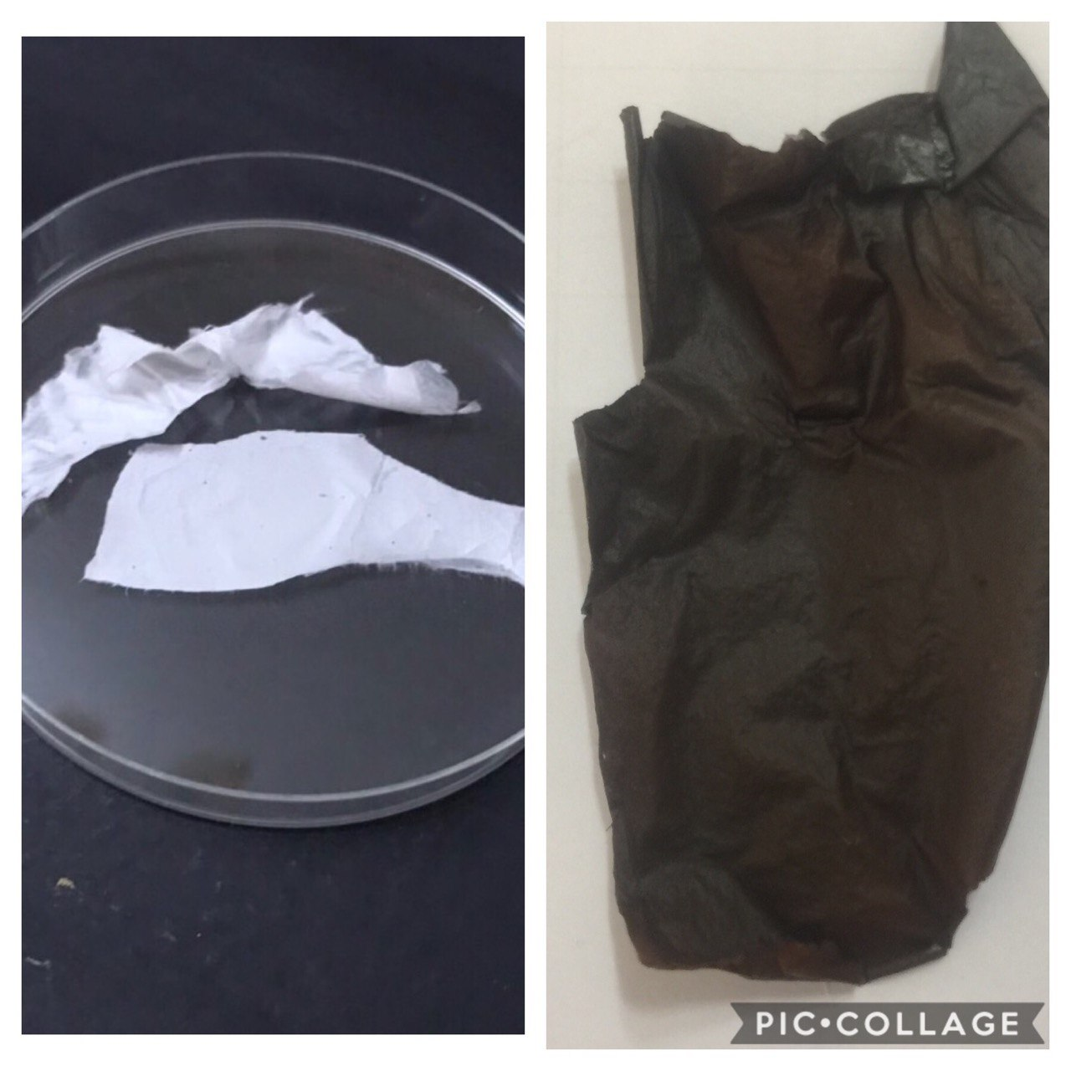

Slide 24
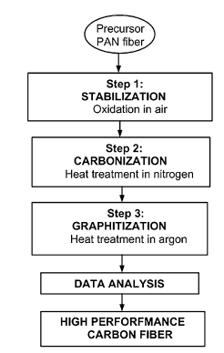
What happens when the PAN is heated thermally ?
i. Oxidative stabilization, which forms ladder structure to
enable them to undergo processing at higher temperatures.
ii. High temperature carbonization, (1600 C) to keep out
noncarbon atoms and yield a turbostatic structure.
iii. Further heat up to 2000 C to improve the orientation of
the basal planes and the stiffness of fibers, which is
called graphitization.
PAN precursor carbon fiber conversion process

Slide 25
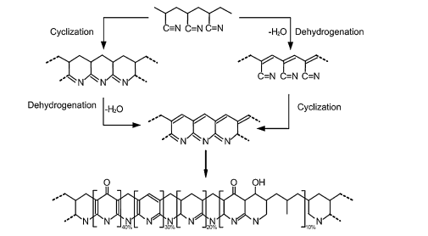
Proposed chemistry of PAN stabilization

Slide 26
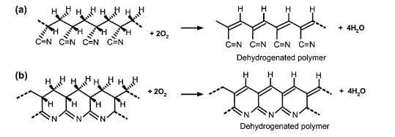
The dehydrogenation reaction during stabilization process: (a) PAN polymer; (b) cyclized PAN

Slide 27
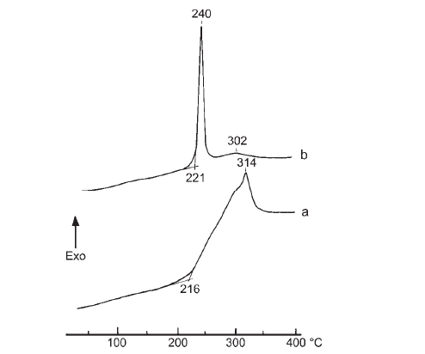
Question
DSC curves of PAN samples obtained in a . bulk form and b . using DMF

Slide 28
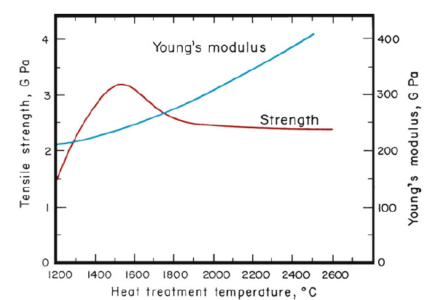
Strength and elastic modulus of carbon fiber as a function of final heat treatmenttemperature [after Watt (1970), used with permission]

Slide 29
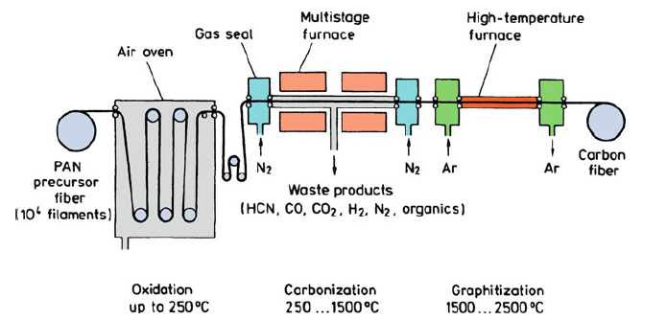
Schematic of PAN-based carbon fiber production [reprinted with permission from
Baker (1983)]
.

Slide 30
4- Organic Fibers
in order to
obtain high-stiffness and high-strength polymers we must extend these polymer
chains and pack them in a parallel array.,
The orientation of these polymer chains
with respect to the fiber axis and the manner in which they fit together (i.e., order or
crystallinity) are controlled by their chemical nature and the processing route
Two very different
approaches have been taken to make high-modulus organic fibers. These are:
1- Process the conventional flexible-chain polymers in such a way that the internal
structure takes a highly oriented and extended-chain arrangement.
,

Slide 31
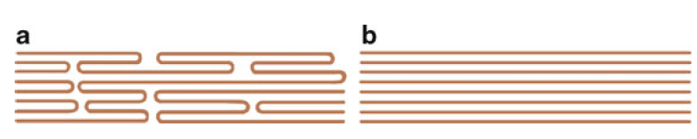
Two types of molecular orientation: (a) oriented without high molecular extension and
(b) oriented with high molecular extension [from Barham and Keller (1985), used with permission]
2- radically different, approach involves synthesis, followed by extrusion
of a new class of polymers, called liquid crystal polymers

Slide 32
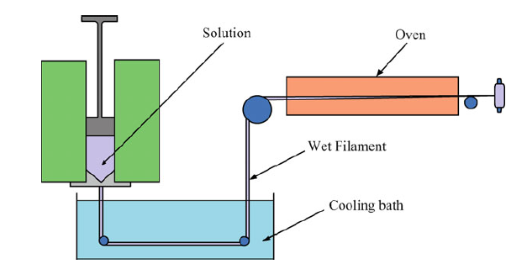
1-4- Oriented Polyethylene Fibers
Gel spinning process for making the high-modulus polyethylene fiber concentration

Slide 33
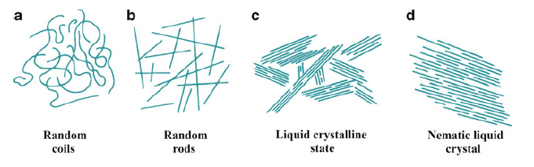
2-4 .Aramid Fibers
Aramid fiber is a generic term for a class of synthetic organic fibers called aromatic
polyamide fibers, Kevlar and Nomex (Du Pont) and Twaron (Teijin Aramid).
Q: What is the basic different between Kevlar fibers and Nomex fibers
The
rigid rodlike structure results in a high glass transition temperature and poor
solubility, which makes fabrication of these polymers, by conventional drawing
techniques, difficult
Various states of polymer in solution: (a) two-dimensional, linear, flexible chains
(random coils), (b) random array of rods, (c) partially ordered liquid crystalline state, and
(d) nematic liquid crystal (randomly distributed parallel rods)

Slide 34
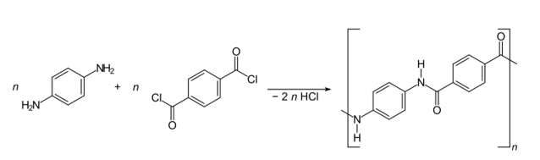
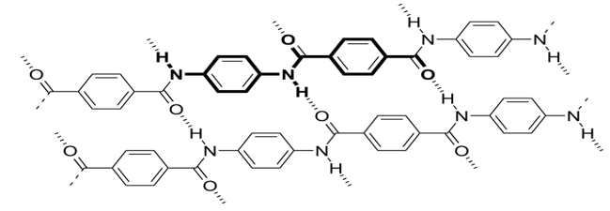

Slide 35
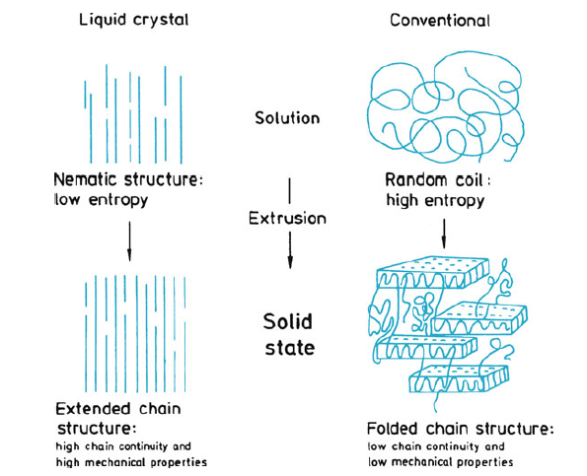
Comparison of dry jet–wet spinning of nematic liquid crystalline solution and conventional spinning of a polymer

Slide 36
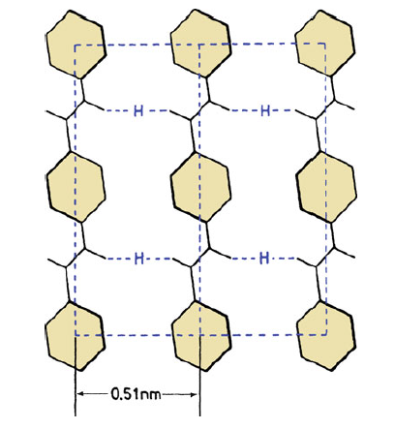
Strong covalent bonding in the fiber direction and weak hydrogen bonding
(indicated by H) in the transverse direction

